Slide 1
Lecture 10: Extra Features and Web Design (Part 2)
Tarik Booker
CS 120
California State University, Los Angeles

Slide 2
Topics
Part 1
Floating Elements
Other positioning
Part 2
Extra Features
Javascript Canvas
Website Design

Slide 3
Extra Features
Geolocation
Embedding Fonts
More CSS
Background gradients
Rounded corners
Box shadow

Slide 4
Geolocation
Allows you to get GPS information!
Google service using IP addresses, cell phone ids, and cell tower triangulation to get device coordinates
Performed using a callback function
If the position is readable, then a (user defined) function is called with the position object
If the position is unable to be read, then a (user defined) error function is called (without an object)

Slide 5
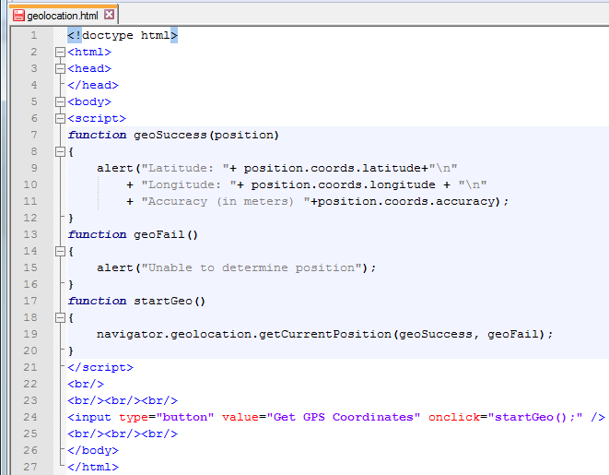
Geolocation (2)
Example:

Slide 6
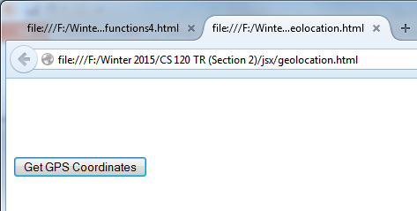
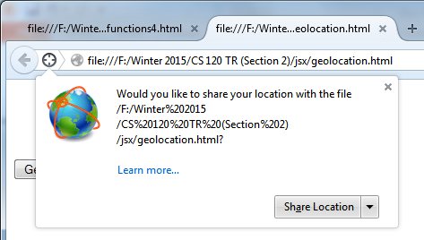
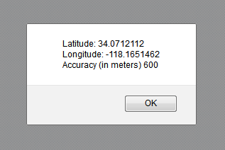
Geolocation (3)

Slide 7
Geolocation (4)
Properties of the Position Object
latitude (in degrees)
longitude (in degrees)
accuracy (in meters)
altitude height (in meters)
altitudeAccuracy (in meters)
heading direction in degrees relative to True North
speed (in meters per second)

Slide 8
Geolocation (5)
You can use the Google Map Services API to display coordinate results on a Google map!
Get GPS coordinates
Display on Google’s map
Through GET
Display Map image URL as the source of an image
Change SRC attribute

Slide 9
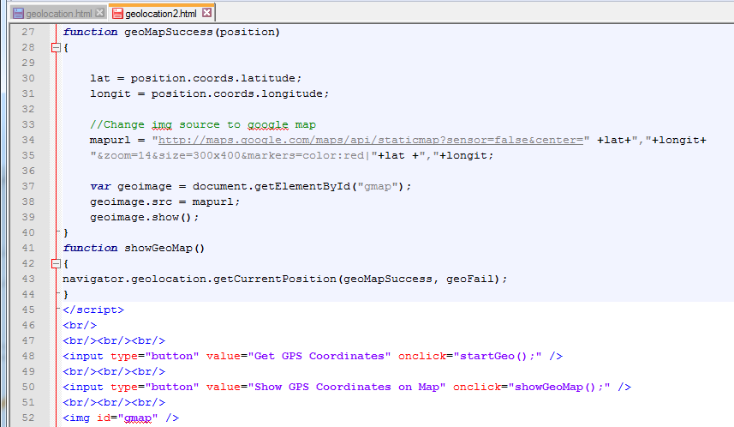
Geolocation (6)

Slide 10
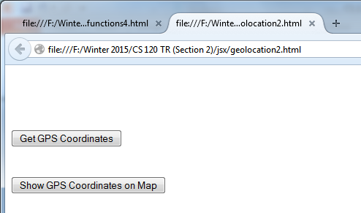
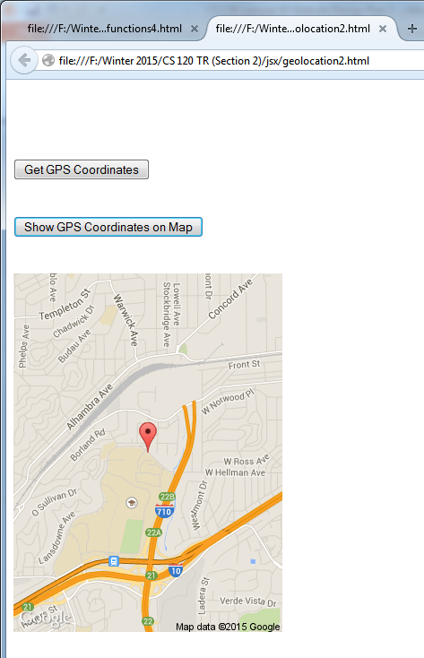
Geolocation (7)

Slide 11
Embedding Fonts
Browsers only support a few fonts
You may need a fancy font for your site
Can embed a font within the page
Have to use the @font-face selector
Example:
@font-face
{
font-family:example;
src: url(“Example.ttf”);
}

Slide 12
More CSS
Background Gradients
Rounded Corners
Box Shadows

Slide 13
Background Gradients
You don’t have to have the background be a specific color.
You can use a “background gradient” to liven it up
A gradient = a transition from one color to another
Use background-image
background-image: linear-gradient(direction, color %, color %, …);

Slide 14
Rounded Corners
Want to add rounded corners to your elements?
Use the border-radius property
Use for each corner of the box
Ex:
Border-radius: 10px 20px 0 20px;

Slide 15
Box Shadows
Want to add shadows to boxes?
Box-shadow property
First two values – shadow offset
Third value – blur radius
Fourth value – how far the blur spreads
Fifth value – specify a different shadow color
Ex:
Box-shadow: 3px 3px 4px 4px red;

Slide 16
Javascript Canvas
Allows you to draw 2D drawings and animations (in Javascript)

Slide 17
Javascript Canvas (2)
Procedure
Create a Canvas element in the HTML
Include id, width, and height attributes
Add an onLoad event in the body tag
Include in the event the function to draw in the canvas
Use getElementById() to get the Canvas object
Use getContext() to the context object
Use functions of the context object to draw

Slide 18
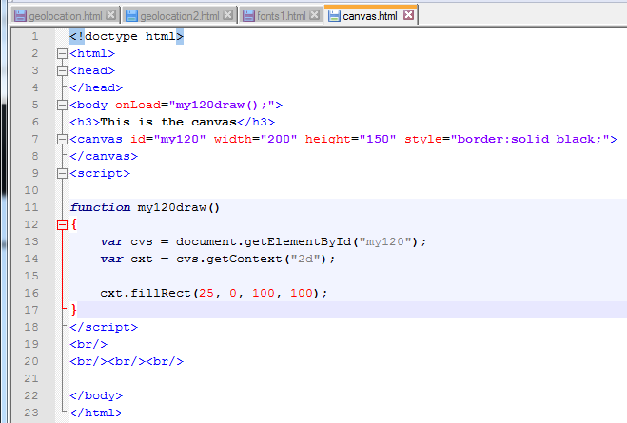
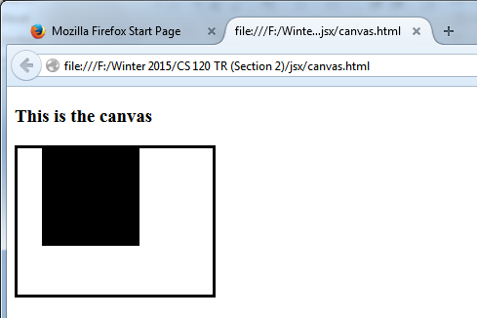
Javascript Canvas (3)
Example:

Slide 19
Javascript Canvas (4)
There are many functions contained within the Canvas
Many things you can do
Book: p540 -547
Draw rectangles, arcs, colors, lines, etc.

Slide 20
Web Site Design
Design Methodologies
Conventions
Design Principles

Slide 21
Design Methodologies
What do users want?
To find what they want quickly (and easily)
Don’t read in an orderly way
Typically click on a link quickly (to get information)
If wrong info, click back button
Users click the back button over 30% of the time at a new site.
Leave if they can’t find what they want (quickly)
You should want to create a page with high usability!

Slide 22
Usability
Usability?
Ease of use of a web site.
Many ways to make using a website easier.
Present essential information “above the fold”
Put important info on top of page
So user doesn’t have to scroll for important info
Group related items into separate components
Limit total number of components on each page
Make things look more manageable

Slide 23
Usability (2)
Clickable links should “look clickable”
We will discuss this later
Non-clickable text shouldn’t look clickable.

Slide 24
Conventions for Usability
Header conventions
Consists of a logo, tag line, utilities, and a navigation bar
Tag line = what’s unique about the site
Navigation bar – links that divide site into sections
Utilities – links to (not primary) information

Slide 25
Conventions for Usability (2)
Navigation Conventions
Underlined text is always a link
Images that are close to short text are clickable
A symbol in front of a text phrase is clickable
Short text phrases in columns are clickable

Slide 26
Conventions
Let users know where they are
Some users may find your page through a search engine
Find a way to let the user know where they are on the page
Breadcrumbs – Mark a path with > in between links

Slide 27
Conventions (2)
Make the best use of web page space
Keep important information “above the fold”
Keep the header relatively small

Slide 28
Conventions (3)
Write for the web
Users skim and scan pages
Chunk long pages into shorter ones
Limit the amount of scrolling on the page

Slide 29
Principles of Graphic Design
Some universal principles of graphic design
https://www.getty.edu/education/teachers/building_lessons/principles_design.pdf
http://en.wikipedia.org/wiki/Design_elements_and_principles

Slide 30
Principles of Graphic Design
Limit line length of paragraphs to 65 characters
Use a sans serif font
Use dark text on a light background

Slide 31
Principles of Modern Website Design
Design changes from trend to trend
Current trends:
http://blog.hubspot.com/marketing/elements-of-modern-web-design-list
Modern design
Single Page (all in one)
http://www.1stwebdesigner.com/single-page-website-designs/

Slide 32
Color Theory
http://en.wikipedia.org/wiki/Color_theory
It’s a good idea to choose a pallete
A range of colors to use for a work of art
Typically 4-5 total for the whole site
Useful to keep unified

